Slide 1
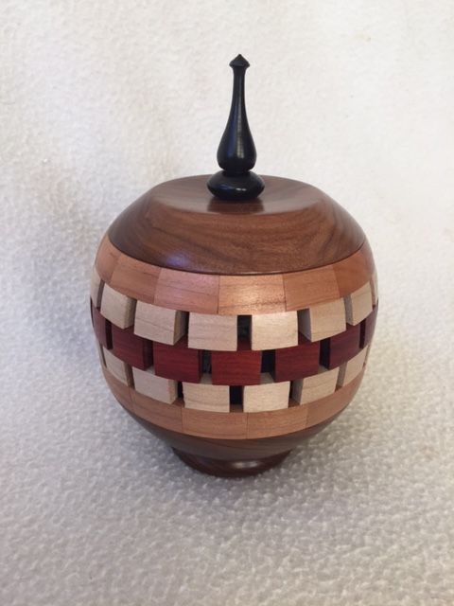
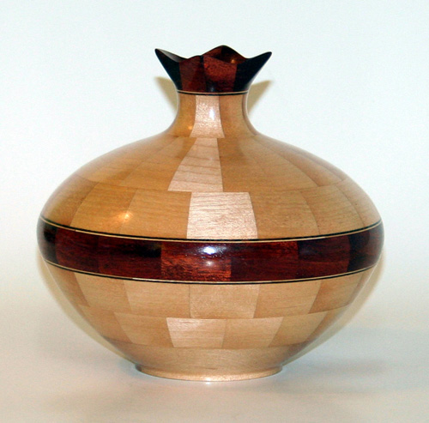
BALTIMORE AREA TURNERS
November 2016
Ron Ford
Don Keefer
RNI
NG
TU
TED
MEN
SEG

Slide 2
Segmented turning
“No one in their right mind does segmented turning”

Slide 3
Why do Segmented Turning?
How does it compare to turning a log ?
Why do segmented turning ?
Allows for greater creativity
Use up small pieces
Much less waste
Combine multiple species of wood
No end grain turning
Can take many forms
Bowls, lidded vessels, urns, etc

Slide 4
What tools are required?
Table saw / Miter saw / Bandsaw
Sander
Belt or Disc (with jig)
Accurate protractor / miter gauge
Thickness sander (optional)
Table saw sled (optional)
Lathe

Slide 5
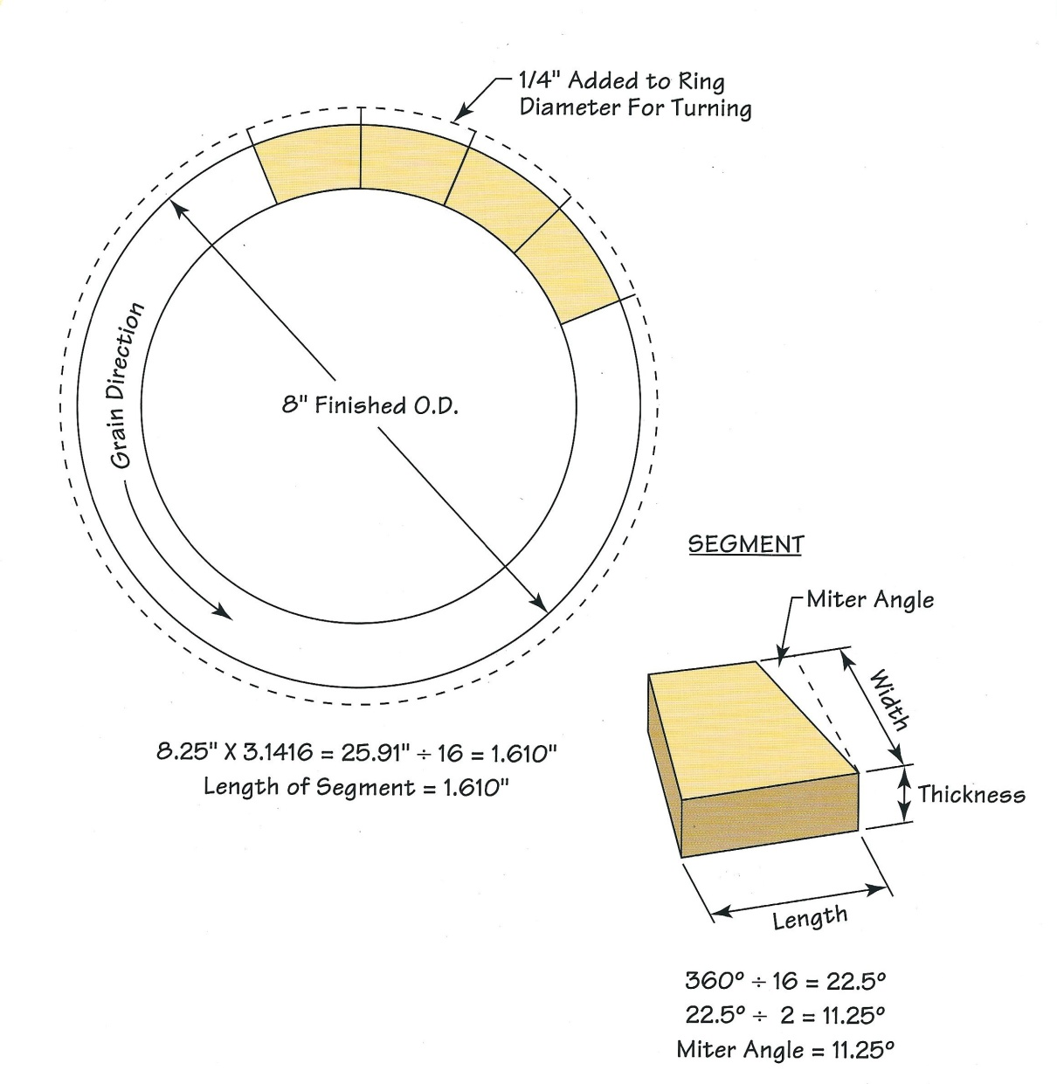
It is made from a stack of rings
Rings built from segments
Terminology
Segment
Thickness
Length
Width
Miter angle

Slide 6
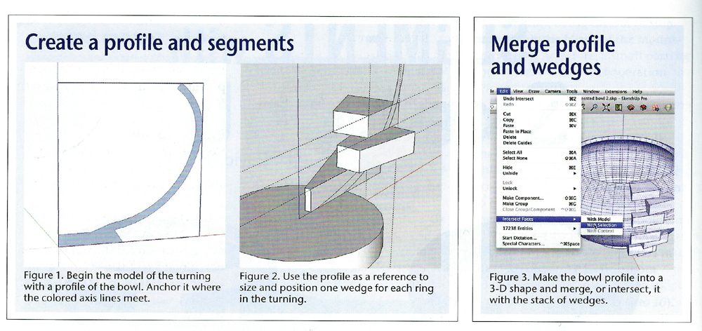
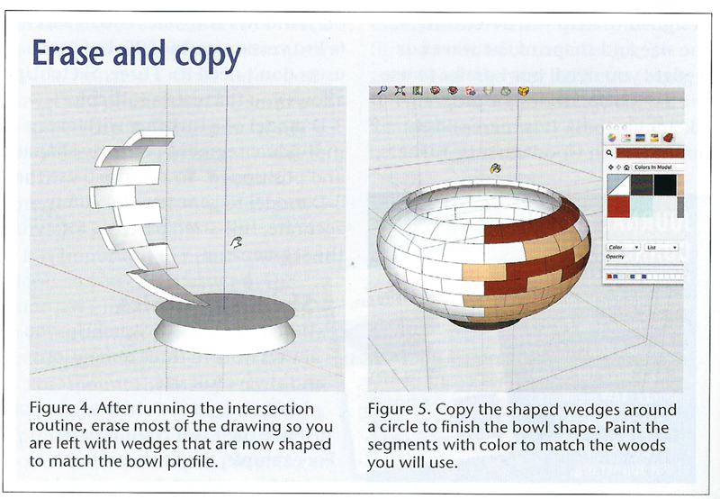
PLANNING, PLANNING, PLANNING….
Draw layout with CAD software like SketchUp
(American Woodturner 31: Aug 16)
or…

Slide 7
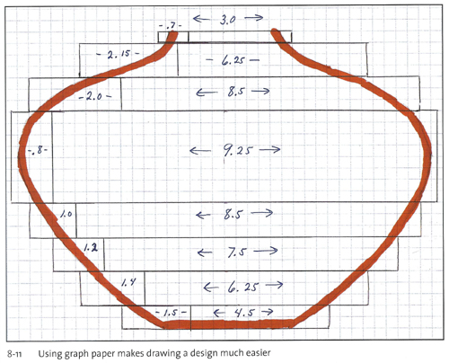
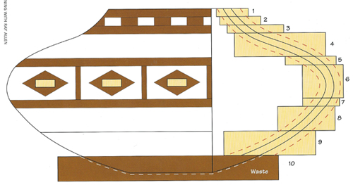
PLANNING, PLANNING, PLANNING….
Draw layout on graph paper

Slide 8
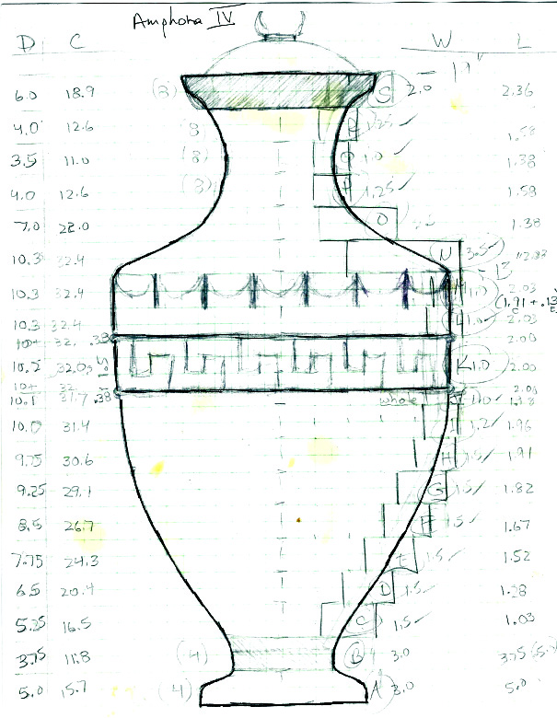
PLANNING, PLANNING, PLANNING….
Draw layout on graph paper

Slide 9
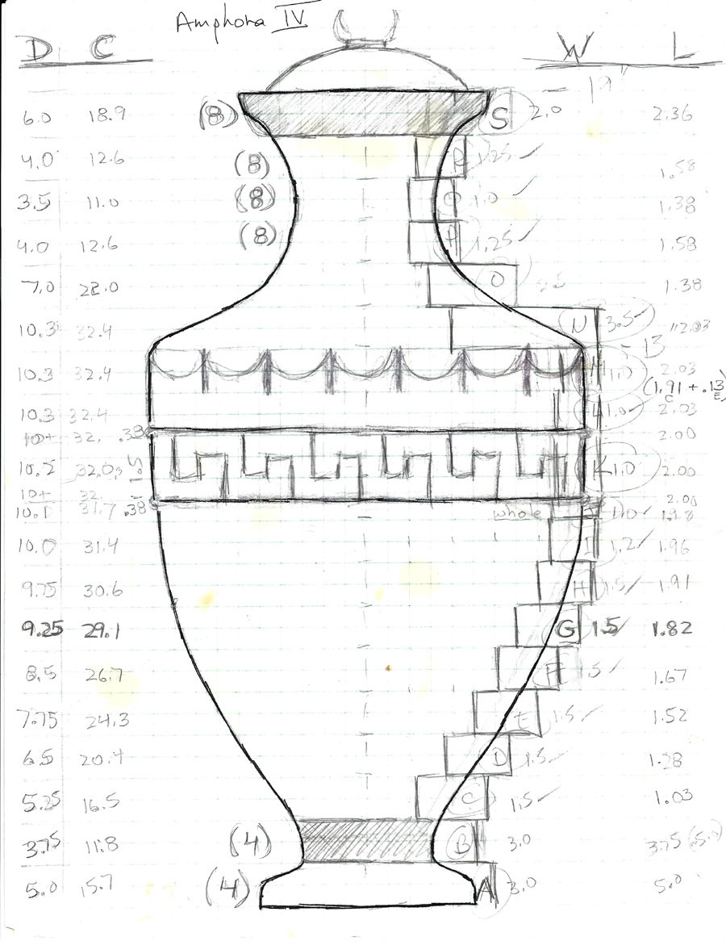
PLANNING, PLANNING, PLANNING….
Draw layout on graph paper
S
Plan the number, the thickness, and species of each ring
How many rings? [rings A thru S] (19)
1. Determine max diameter of each ring
G
A

Slide 10
PLANNING, PLANNING, PLANNING….
1. Determine max diameter of each ring
2. Calculate circumference of each ring
= Diameter x 3.14
3. Decide on number of segments per ring *
4 or 8 or 12 or 16 or…
S
*
*
A

Slide 11
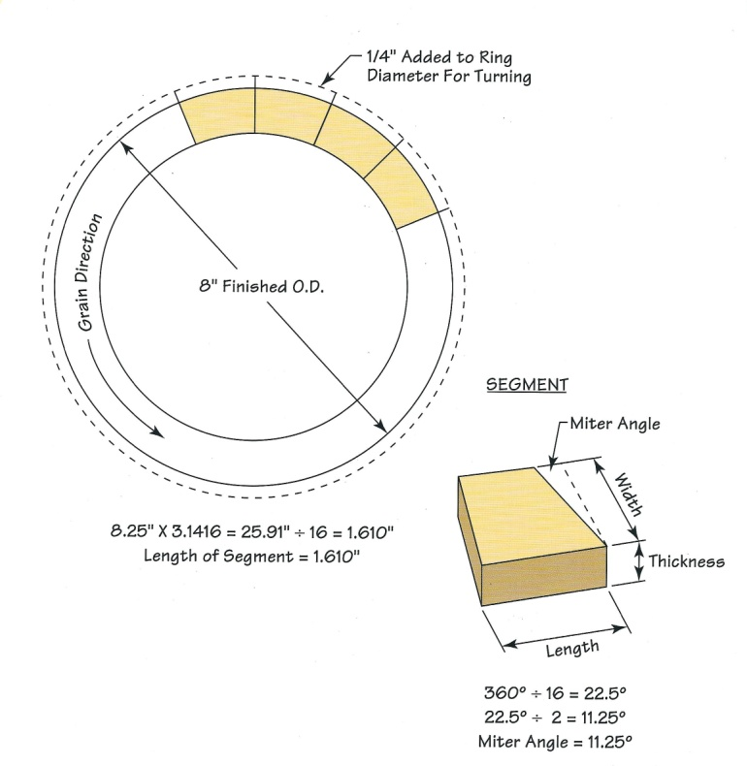
PLANNING, PLANNING, PLANNING….
4. Calculate length of each segment
= Circumference / # of segments

Slide 12
PLANNING, PLANNING, PLANNING….
5. Calculate miter angle of each segment
Miter angle = 360º / # of segments /2
eg. 360º / 16 segments / 2 = 11.25º

Slide 13
PLANNING, PLANNING, PLANNING….
6. Determine width of each segment/ring
What affects width?
7. Include a feature ring?
Design the details of the ring

Slide 14
PLANNING, PLANNING, PLANNING….
Or, in lieu of calculating it all….

Slide 15
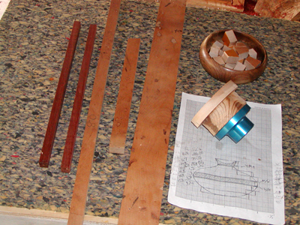
The Basics
There is more than one way to skin a cat – or to make a segmented turning
Cut strips on table saw
Length and width of each strip is determined by your calculations

Slide 16
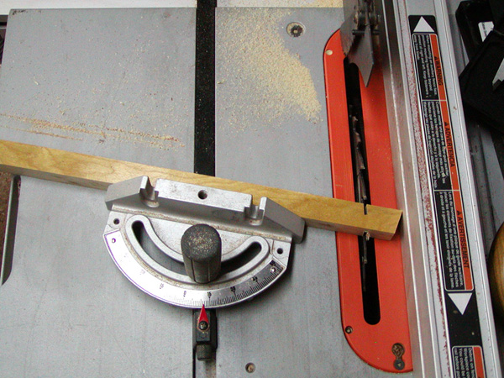
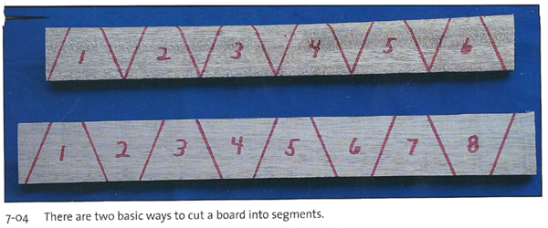
The Basics
Cutting, cutting, cutting….
Use a miter gauge to cut segments
Choose correct angle and length for each segment
Flip strip between each cut … or not…..

Slide 17
The Basics
The base?
Attach waste block to faceplate
Glue base onto waste block
Several design possibilities for the base:
- One solid piece
- Segmented
- Tapered Plug or
- Floating disc

Slide 18
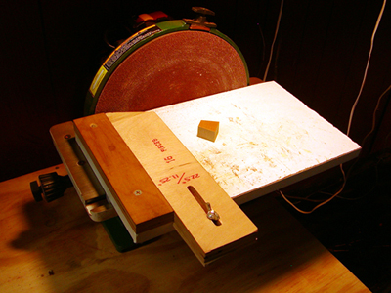
The Basics
After cutting the segments - sand them on disc sander

Slide 19
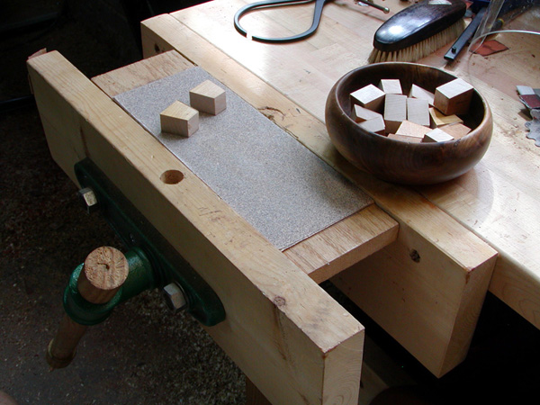
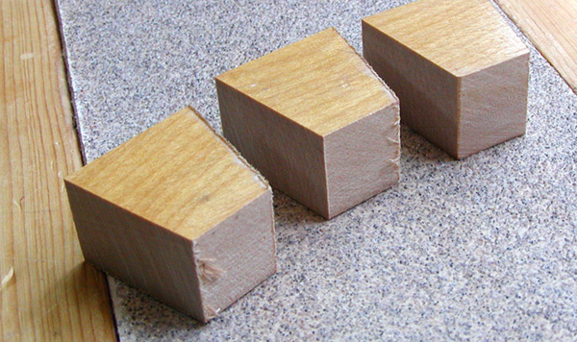
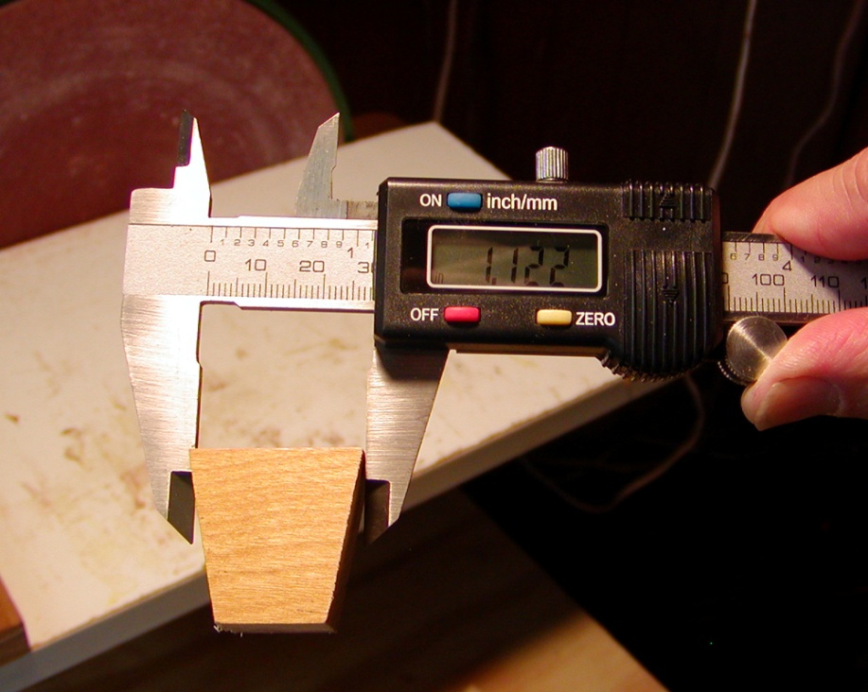
The Basics
Remove sanding fuzz
Re-sand if necessary
Measure length

Slide 20
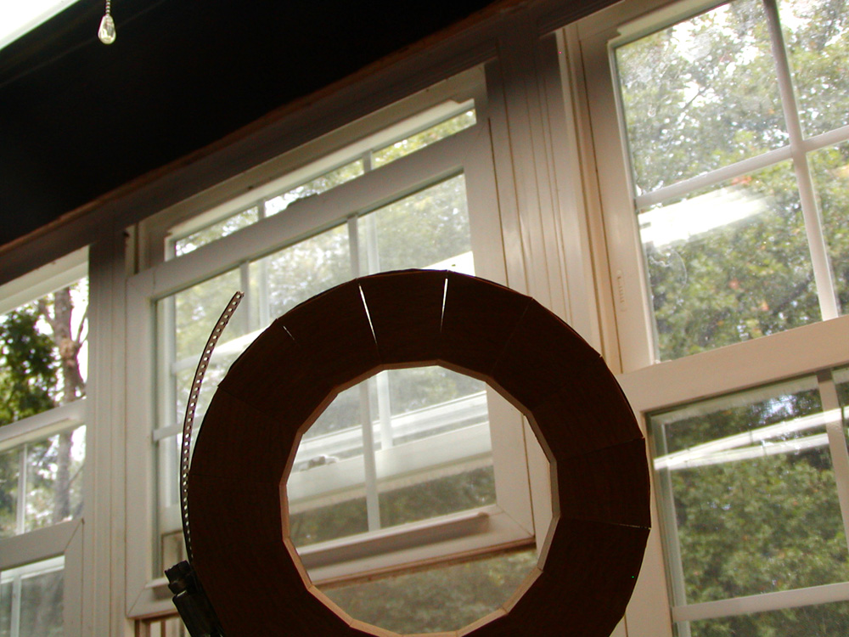
The Basics
No matter how precise you’ve been….
Therefore….

Slide 21
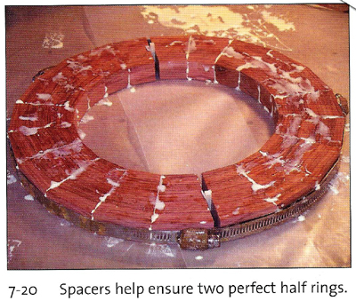
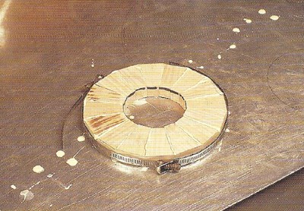
The Basics
Gluing segments
Allen
All at once or…
Each half at once or…

Slide 22
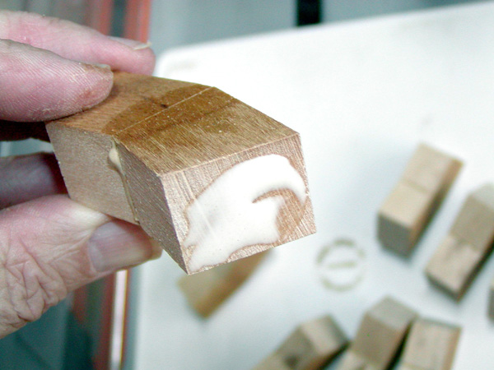
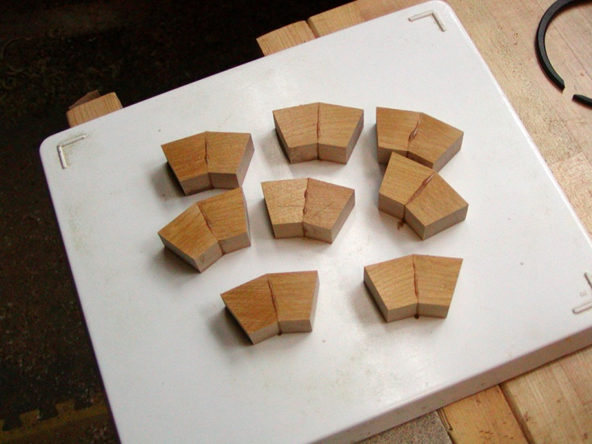
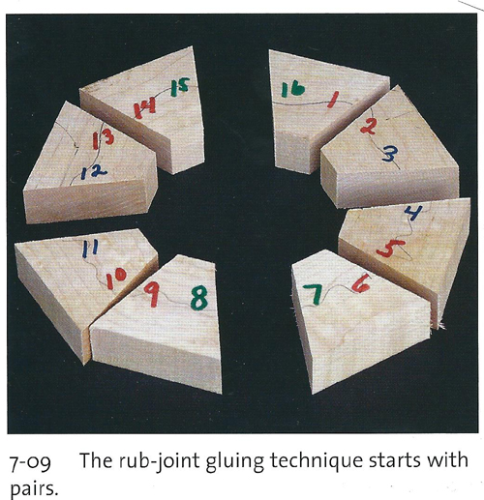
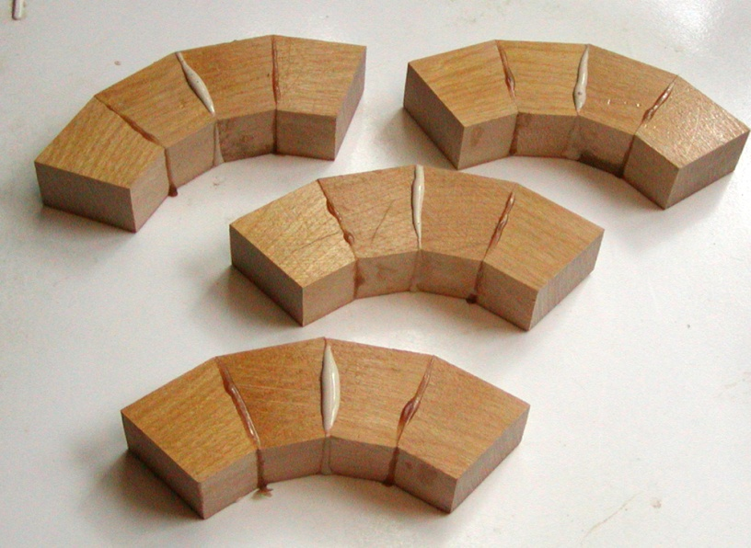
The Basics
Gluing segments
Tibbetts
Two ** at a time

Slide 23
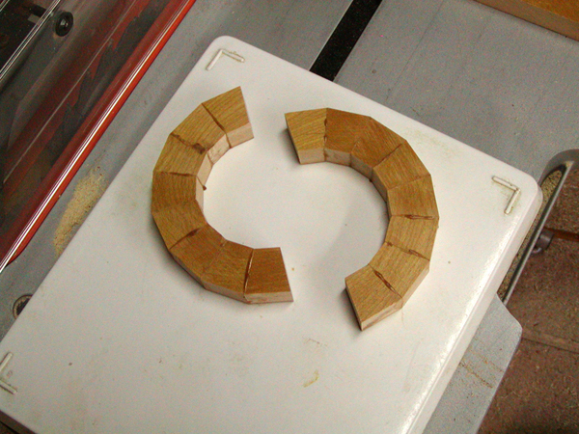
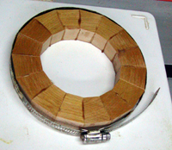
The Basics
Gluing segments

Slide 24
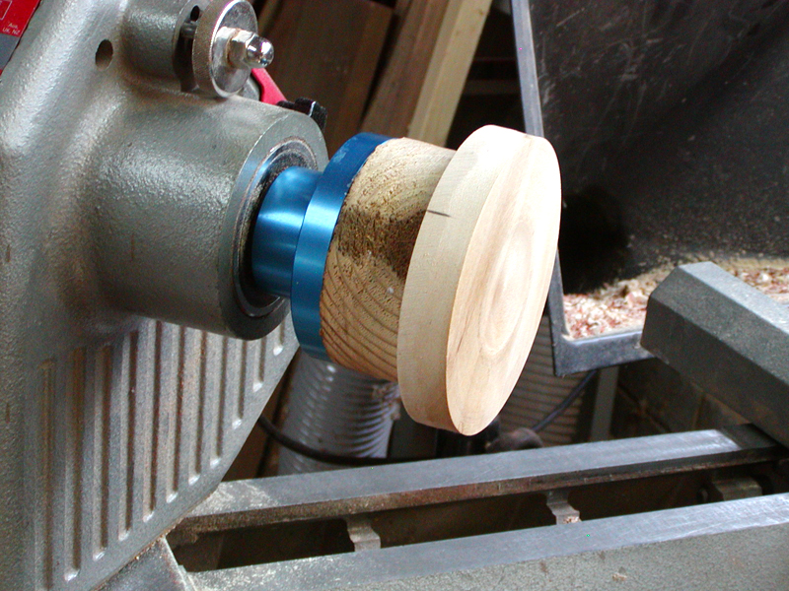
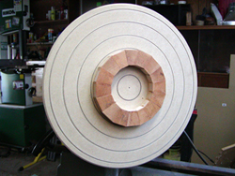
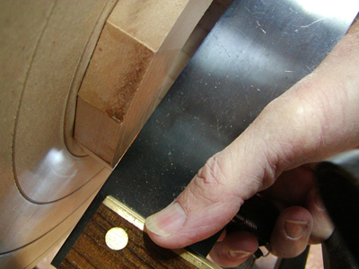
The Basics
Assembling the rings…
Flatten face of each ring

Slide 25
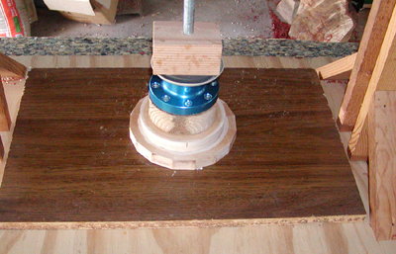
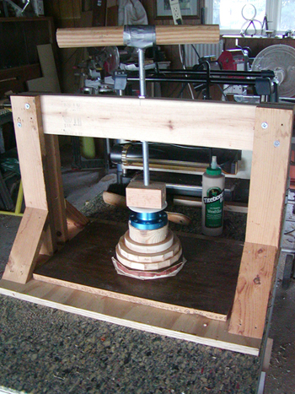
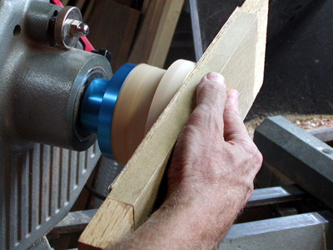
The Basics
Assembling…
Glue rings together

Slide 26
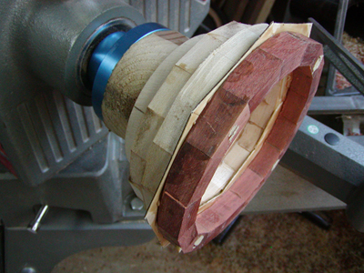
The Basics
Assembling…
Flattening… gluing… flattening… gluing….
flattening.…
gluing…

Slide 27
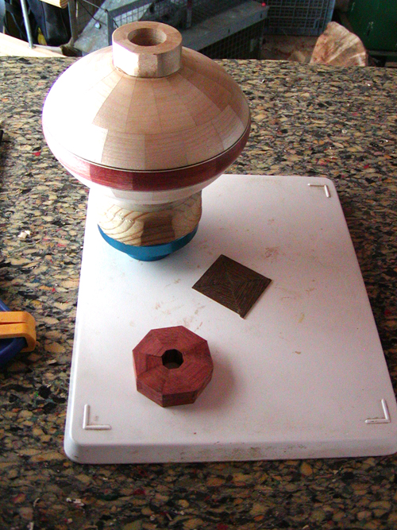
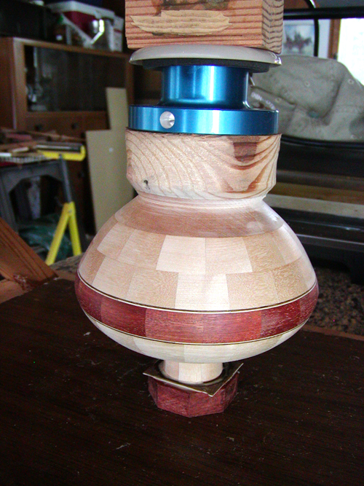
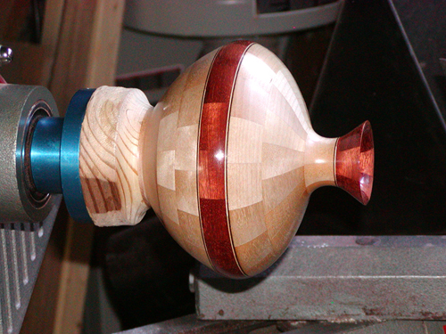
The Basics
Assembling & finishing
Final steps

Slide 28
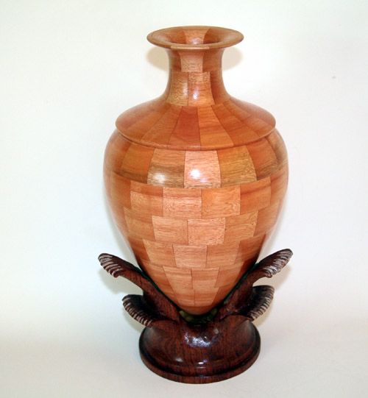
The icing on the cake: A feature ring OR OTHER EMBELLISHMENT
(Optional)
Plain

Slide 29
The icing on the cake: A feature ring OR OTHER EMBELLISHMENT
(Optional)
A simple band

Slide 30
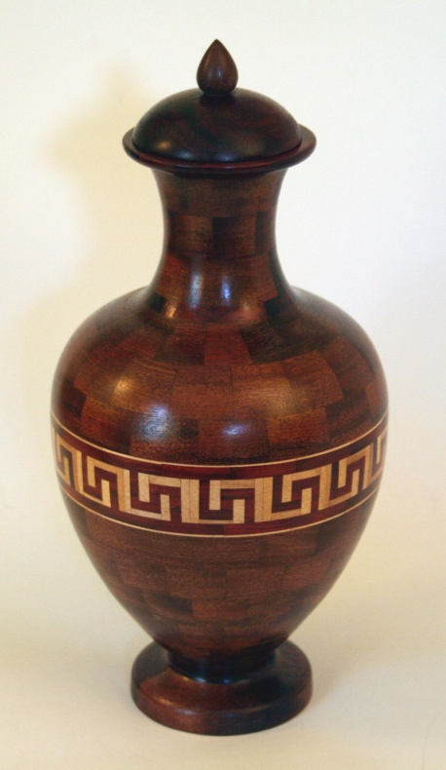
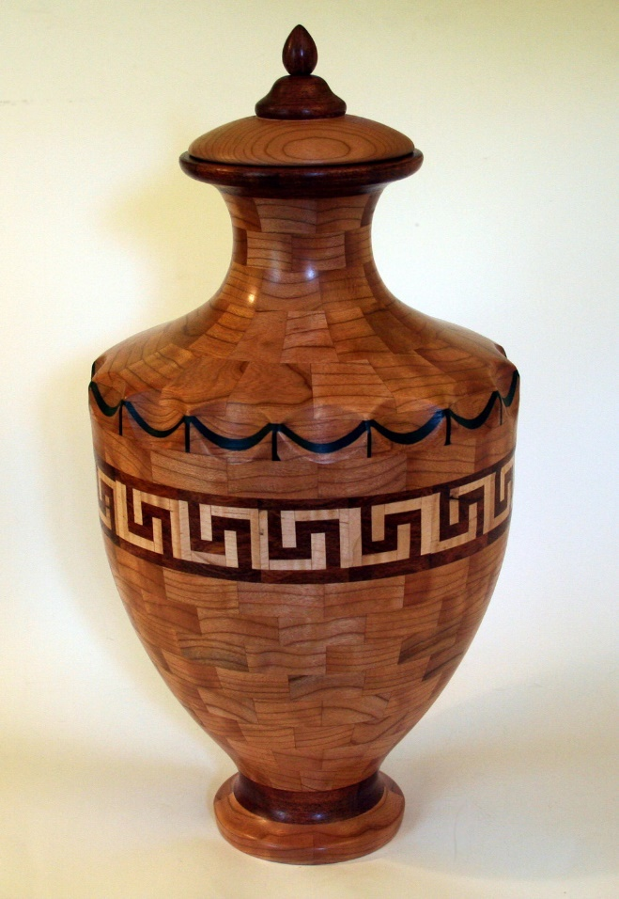
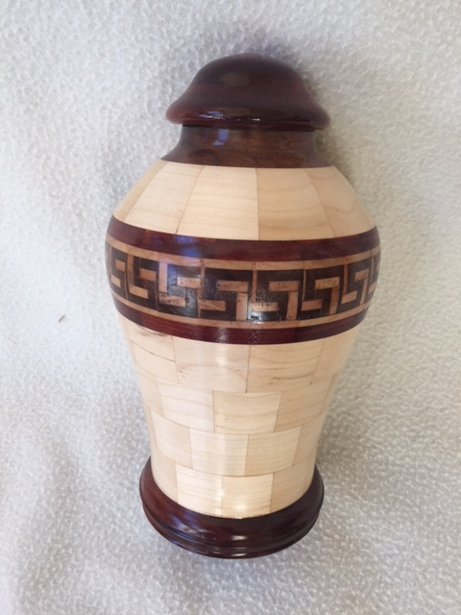
The icing on the cake: A feature ring
A Greek Key

Slide 31
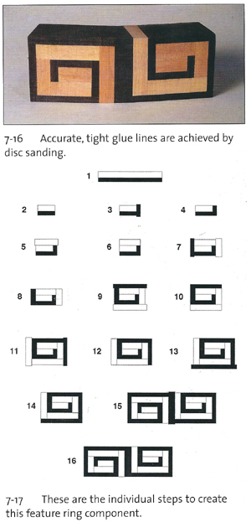
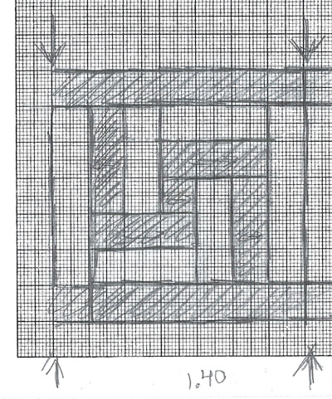
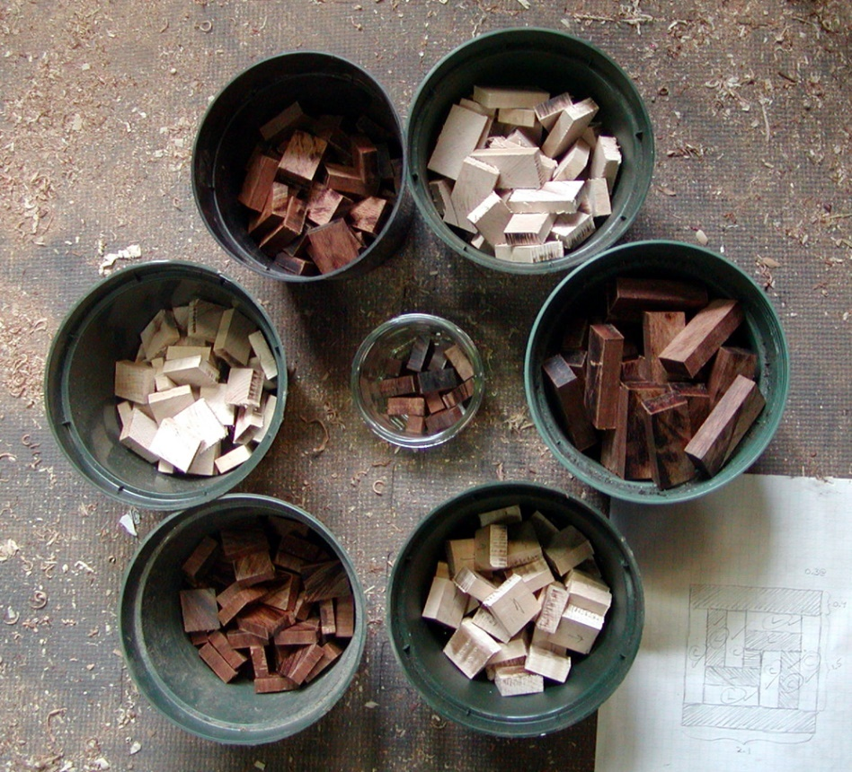
The icing on the cake: A feature ring
Greek Key
Orientation of grain can be important

Slide 32
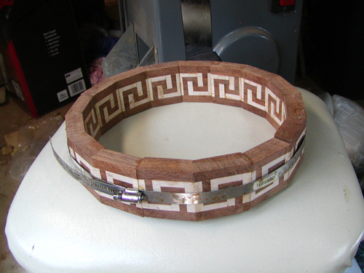
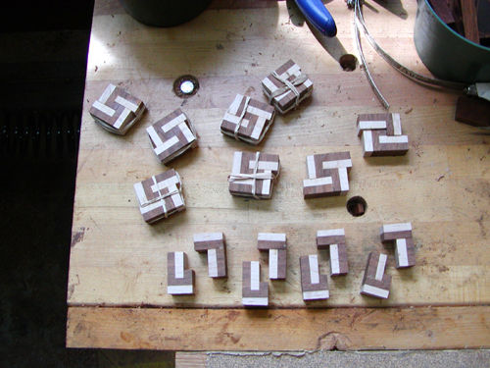
The icing on the cake: A feature ring
Greek Key

Slide 33
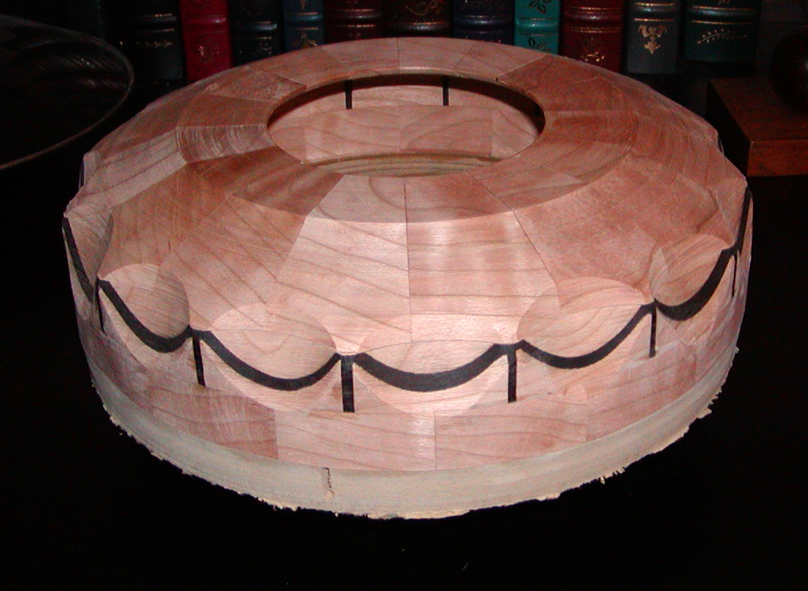
The icing on the cake: A feature ring
Greek Key +

Slide 34
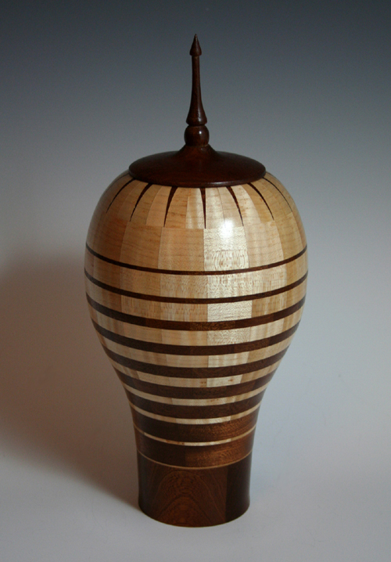
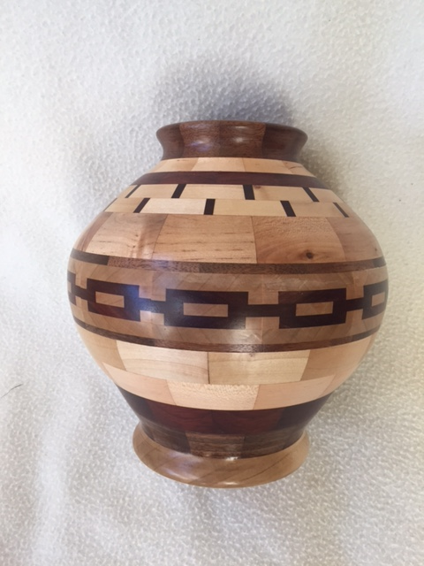
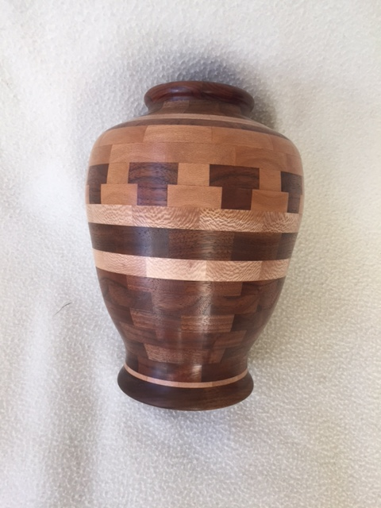
A feature ring or other embellishments

Slide 35
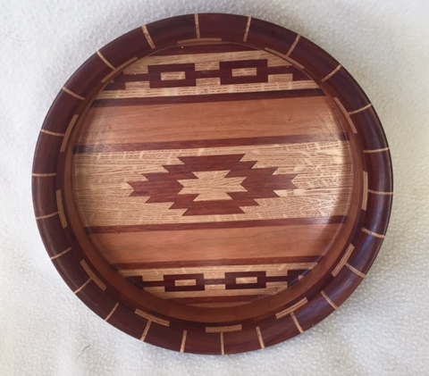
The icing on the cake:

Slide 36
the feature ring or other embellishments

Slide 37
And Other variations…
Open segments

Slide 38
And Other variations…
Keep it simple…

Slide 39
Conclusion
“No one in their right mind does segmented turning”
But who cares! It can be very rewarding….

